Slide 1

HarvestIQ – Data-Driven Crop Yield Prediction
Final Project Review | Department of CSE | [Koneru Lakshmaiah Education Foundation]
TEAM MEMBERS
2420030042 – Pathi Sharmila
2420030225 – Sanivarapu Sadhana
2420030336 – M. Pavani Sree
Guide: Dr.N.Sunanda, Associate Professor |Academic Year: [2026–27]
Notes:
Title slide. Replace all bracketed text. Use the full project title, list every team member with registration number, and name your guide. Insert the institution logo in the dashed box.

Slide 2

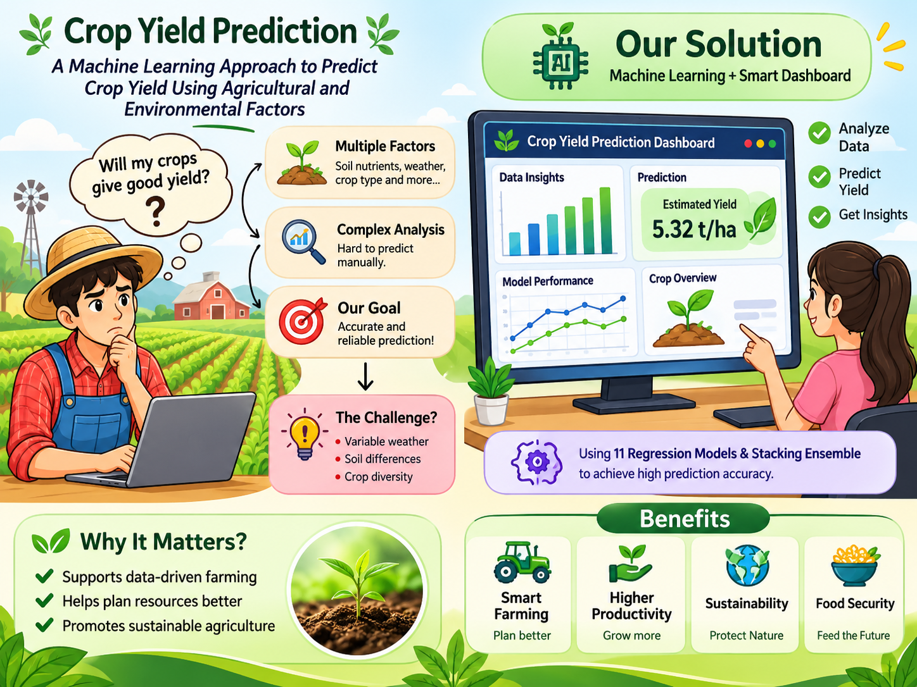


Introduction & Problem Statement
Background
[
Agriculture plays a significant role in food security and economic development. Crop yield is influenced by several agricultural and environmental factors, including soil nutrients, soil conditions, temperature, rainfall, humidity, and farming practices.
Problem Statement
Crop yield depends on multiple interacting agricultural and environmental factors. Analysing these factors manually makes it difficult to understand their combined influence and produce consistent yield estimates.
Motivation / Need
Support data-driven agricultural planning.Help understand the relationship between environmental conditions and crop yield.Compare different machine learning models for yield estimation.Provide an accessible interface for obtaining crop yield predictions.
Notes:
State the domain, the exact problem and why it matters. Keep it to about 2 minutes. Add one real-world statistic if you can, with a citation.

Slide 3


Objectives & Scope
Objectives
1
Develop a machine learning pipeline for predicting crop yield using agricultural and environmental factors.
2
Perform data preprocessing, exploratory data analysis and feature engineering on the agricultural dataset.
3
Implement and evaluate multiple regression algorithms to identify the best-performing model.
4
Develop an interactive Streamlit dashboard for crop yield prediction, model evaluation and dataset insights.
Notes:
Objectives should be measurable and start with action verbs. The scope slide tells the panel what you did and did not attempt.

Slide 4

Literature Survey
S.No | Author(s) & Year | Method / Technique | Key Findings | Limitation / Gap
1 | Jun Wu et al. (2021) | Improved RFM, K-Means++ | Improves customer-value identification. | Identifies factors influencing cart abandonment.
2 | Zengyuan Wu et al. (2022) | Improved RFM features, K-Medoids clustering | Enhances e-commerce customer segmentation. | Focuses on clustering rather than an integrated analytics dashboard.
3 | Gomes & Meisen (2023) | Systematic literature review | Reviews customer-segmentation methods and evaluation metrics. | No universal agreement on the best evaluation metrics.
4 | Chopra et al. (2024) | Systematic literature review, lexicometric analysis | Identifies factors influencing cart abandonment. | Further research across contexts is needed.
Research Gap
Existing studies primarily focus on customer segmentation, clustering techniques, or cart abandonment separately. Limited integration of sales analysis, customer behavior, segmentation, and model evaluation leaves room for a unified approach. RetailIQ combines these components to provide comprehensive e-commerce insights. An interactive Streamlit dashboard presents actionable insights to support sales improvement and customer retention.
Notes:
Summarise four to six relevant papers or existing systems. End with the research gap, because that gap justifies your project.

Slide 5





Proposed System & Methodology
STEP 1
STEP 2
STEP 3
STEP 4
STEP 5
Define Problem
Collect Data
Design
Implement
Test & Evaluate
Identify the need for crop yield estimation.
Define agricultural and environmental input variables.
Obtain the crop-yield dataset from Kaggle.
Dataset contains 10,000 records and 20 columns.
Perform exploratory data analysis.Apply feature engineering,feature selection.
Perform an 80:20 train-test split.
Evaluate models using MAE, MSE, RMSE and R².
Implement 11 regression models.
Develop the stacking ensemble.
Key Novelty / Contribution
The contribution of this project is an integrated crop-yield prediction workflow combining preprocessing, six domain-informed engineered features, comparative evaluation of 11 regression models, stacking and an interactive Streamlit dashboard. It focuses on practical integration and evaluation rather than proposing a completely new machine learning algorithm.
Notes:
Walk through the five steps left to right. Rename the steps to match your project (for example, Requirement Analysis, Design, Coding, Testing, Deployment). End with your novelty.

Slide 6
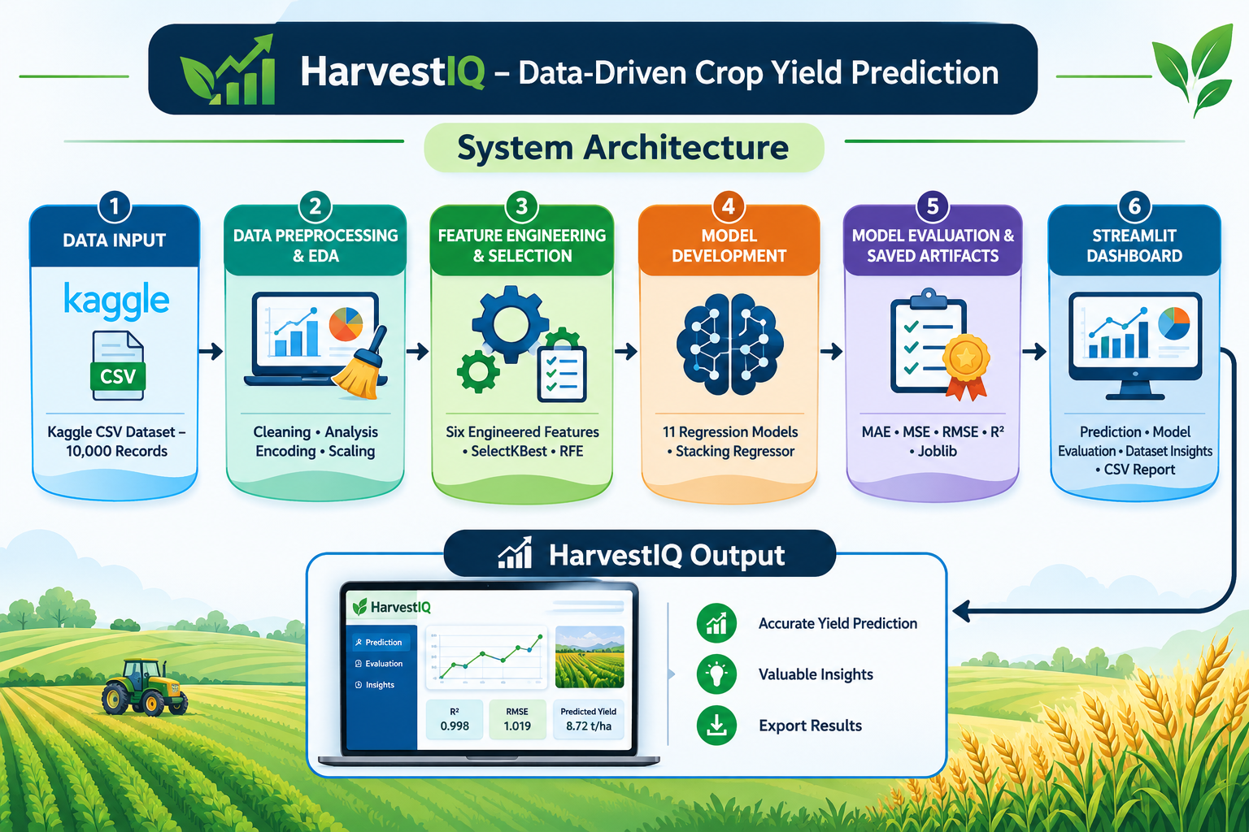
System Architecture
Components
1
Dataset & EDA:
Loads and explores the agricultural dataset.
2
Preprocessing & Feature Engineering:
Cleans, transforms and creates additional features.
3
Machine Learning:
Trains and evaluates regression models.
4
Dashboard & Reporting:
Provides predictions, visualizations and downloadable reports.
Notes:
Insert a clear block diagram: input, processing, storage, output. Number each block and explain them on the right. Redraw the figure yourself rather than copying it.

Slide 7


Hardware & Software Requirements
Hardware
Software & Tools
Libraries / Frameworks
Processor: CPU-based development system.
RAM: Sufficient memory to process the 10,000-row dataset and train models.
Storage: Local storage for datasets, notebooks and model artifacts.
Internet: Required for downloading packages and accessing the dataset.
Operating System: Windows.
Programming Language: Python.
IDE: Visual Studio Code.
Notebook Environment: Jupyter Notebook.
Version Control: Git and GitHub.
Pandas – Data manipulation.
NumPy – Numerical operations.
Scikit-learn – Preprocessing, feature selection and machine learning.
Matplotlib and Seaborn – Data visualization.
XGBoost – Regression modelling.
CatBoost – Regression modelling.
Joblib – Model serialization.
Streamlit – Interactive dashboard development.
Deployment / Platform: Local machine using Streamlit.
Notes:
List only what you actually used, with versions. For a pure software project, shorten the hardware list and add cloud or deployment resources.

Slide 8
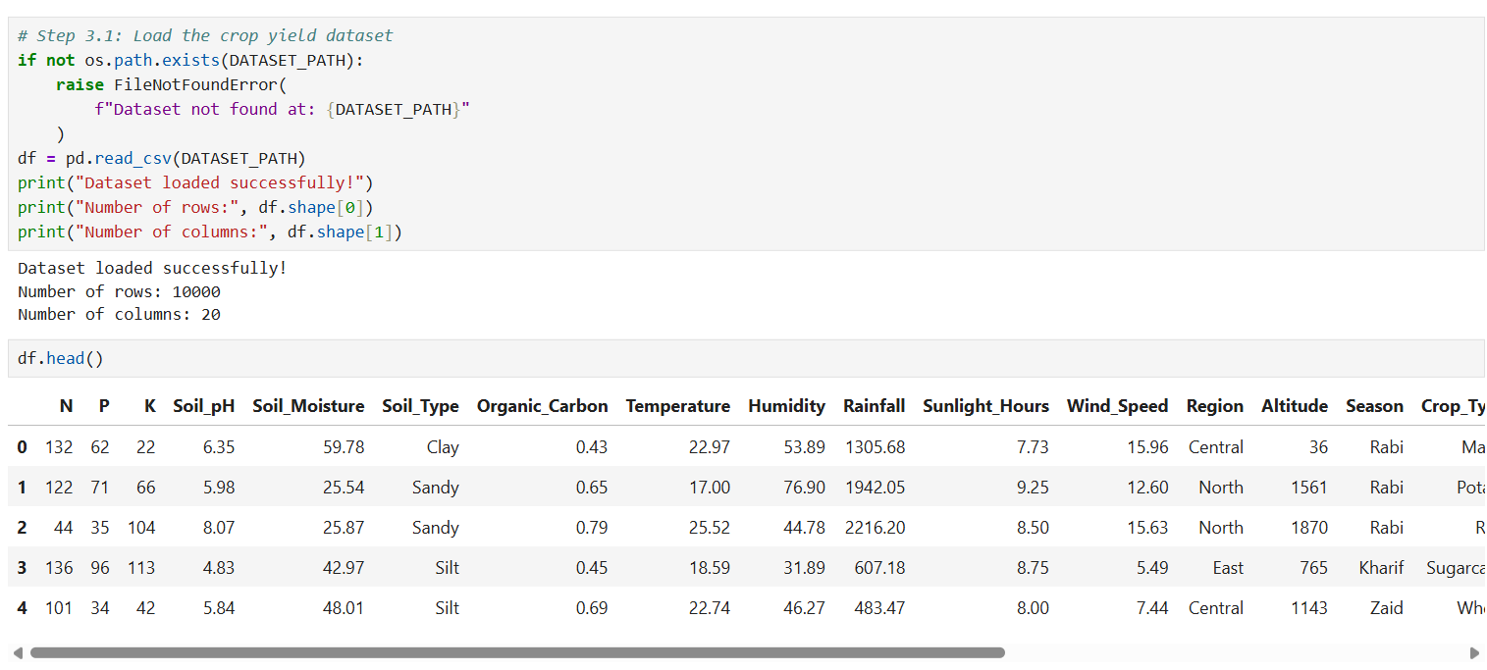
Dataset / Data Understanding
[10,000]
[20]
Records (rows)
Total columns
[19]
[1]
Input features
Continuous target
Source: Kaggle – crop-yield.csv
Features:Soil nutrients,Soil properties,Environmental factors,Geographical and seasonal factors,Agricultural managemen.
QualityDataset contains numerical and categorical features.Missing-value handling is included in the preprocessing pipeline.Numeric and categorical variables are processed separately.The target is continuous; therefore, this is a regression problem, not a classification problem.
Notes:
Explain where the data came from and what it contains. Show a screenshot of the first rows or the info summary. For non-data projects, replace this slide with “Requirement Analysis” or “Input Specification”.

Slide 9
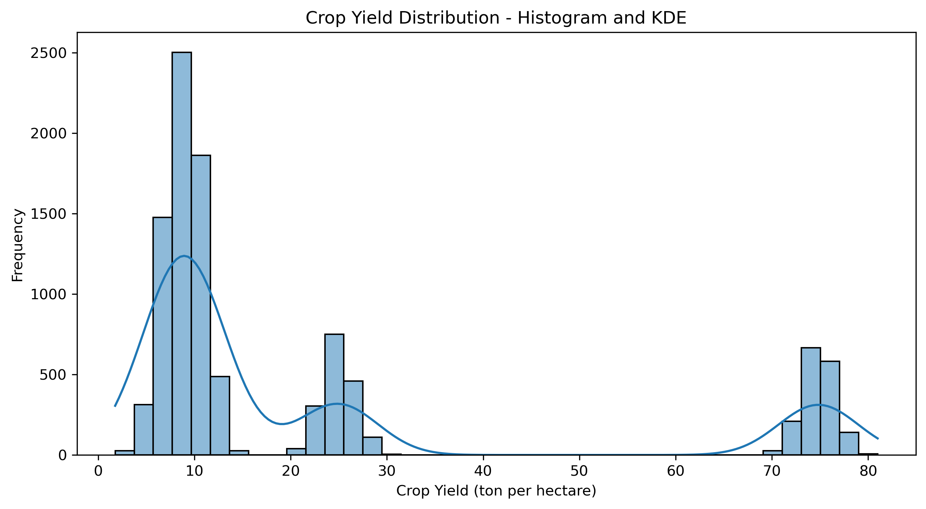
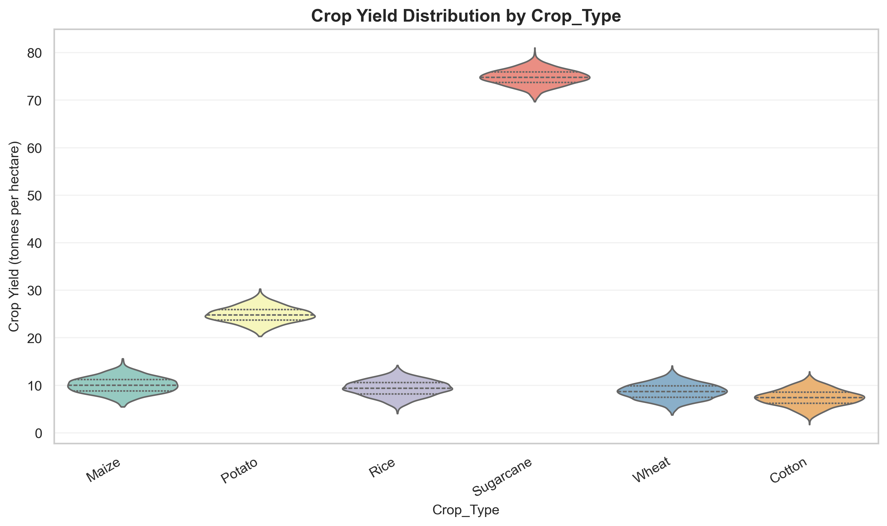
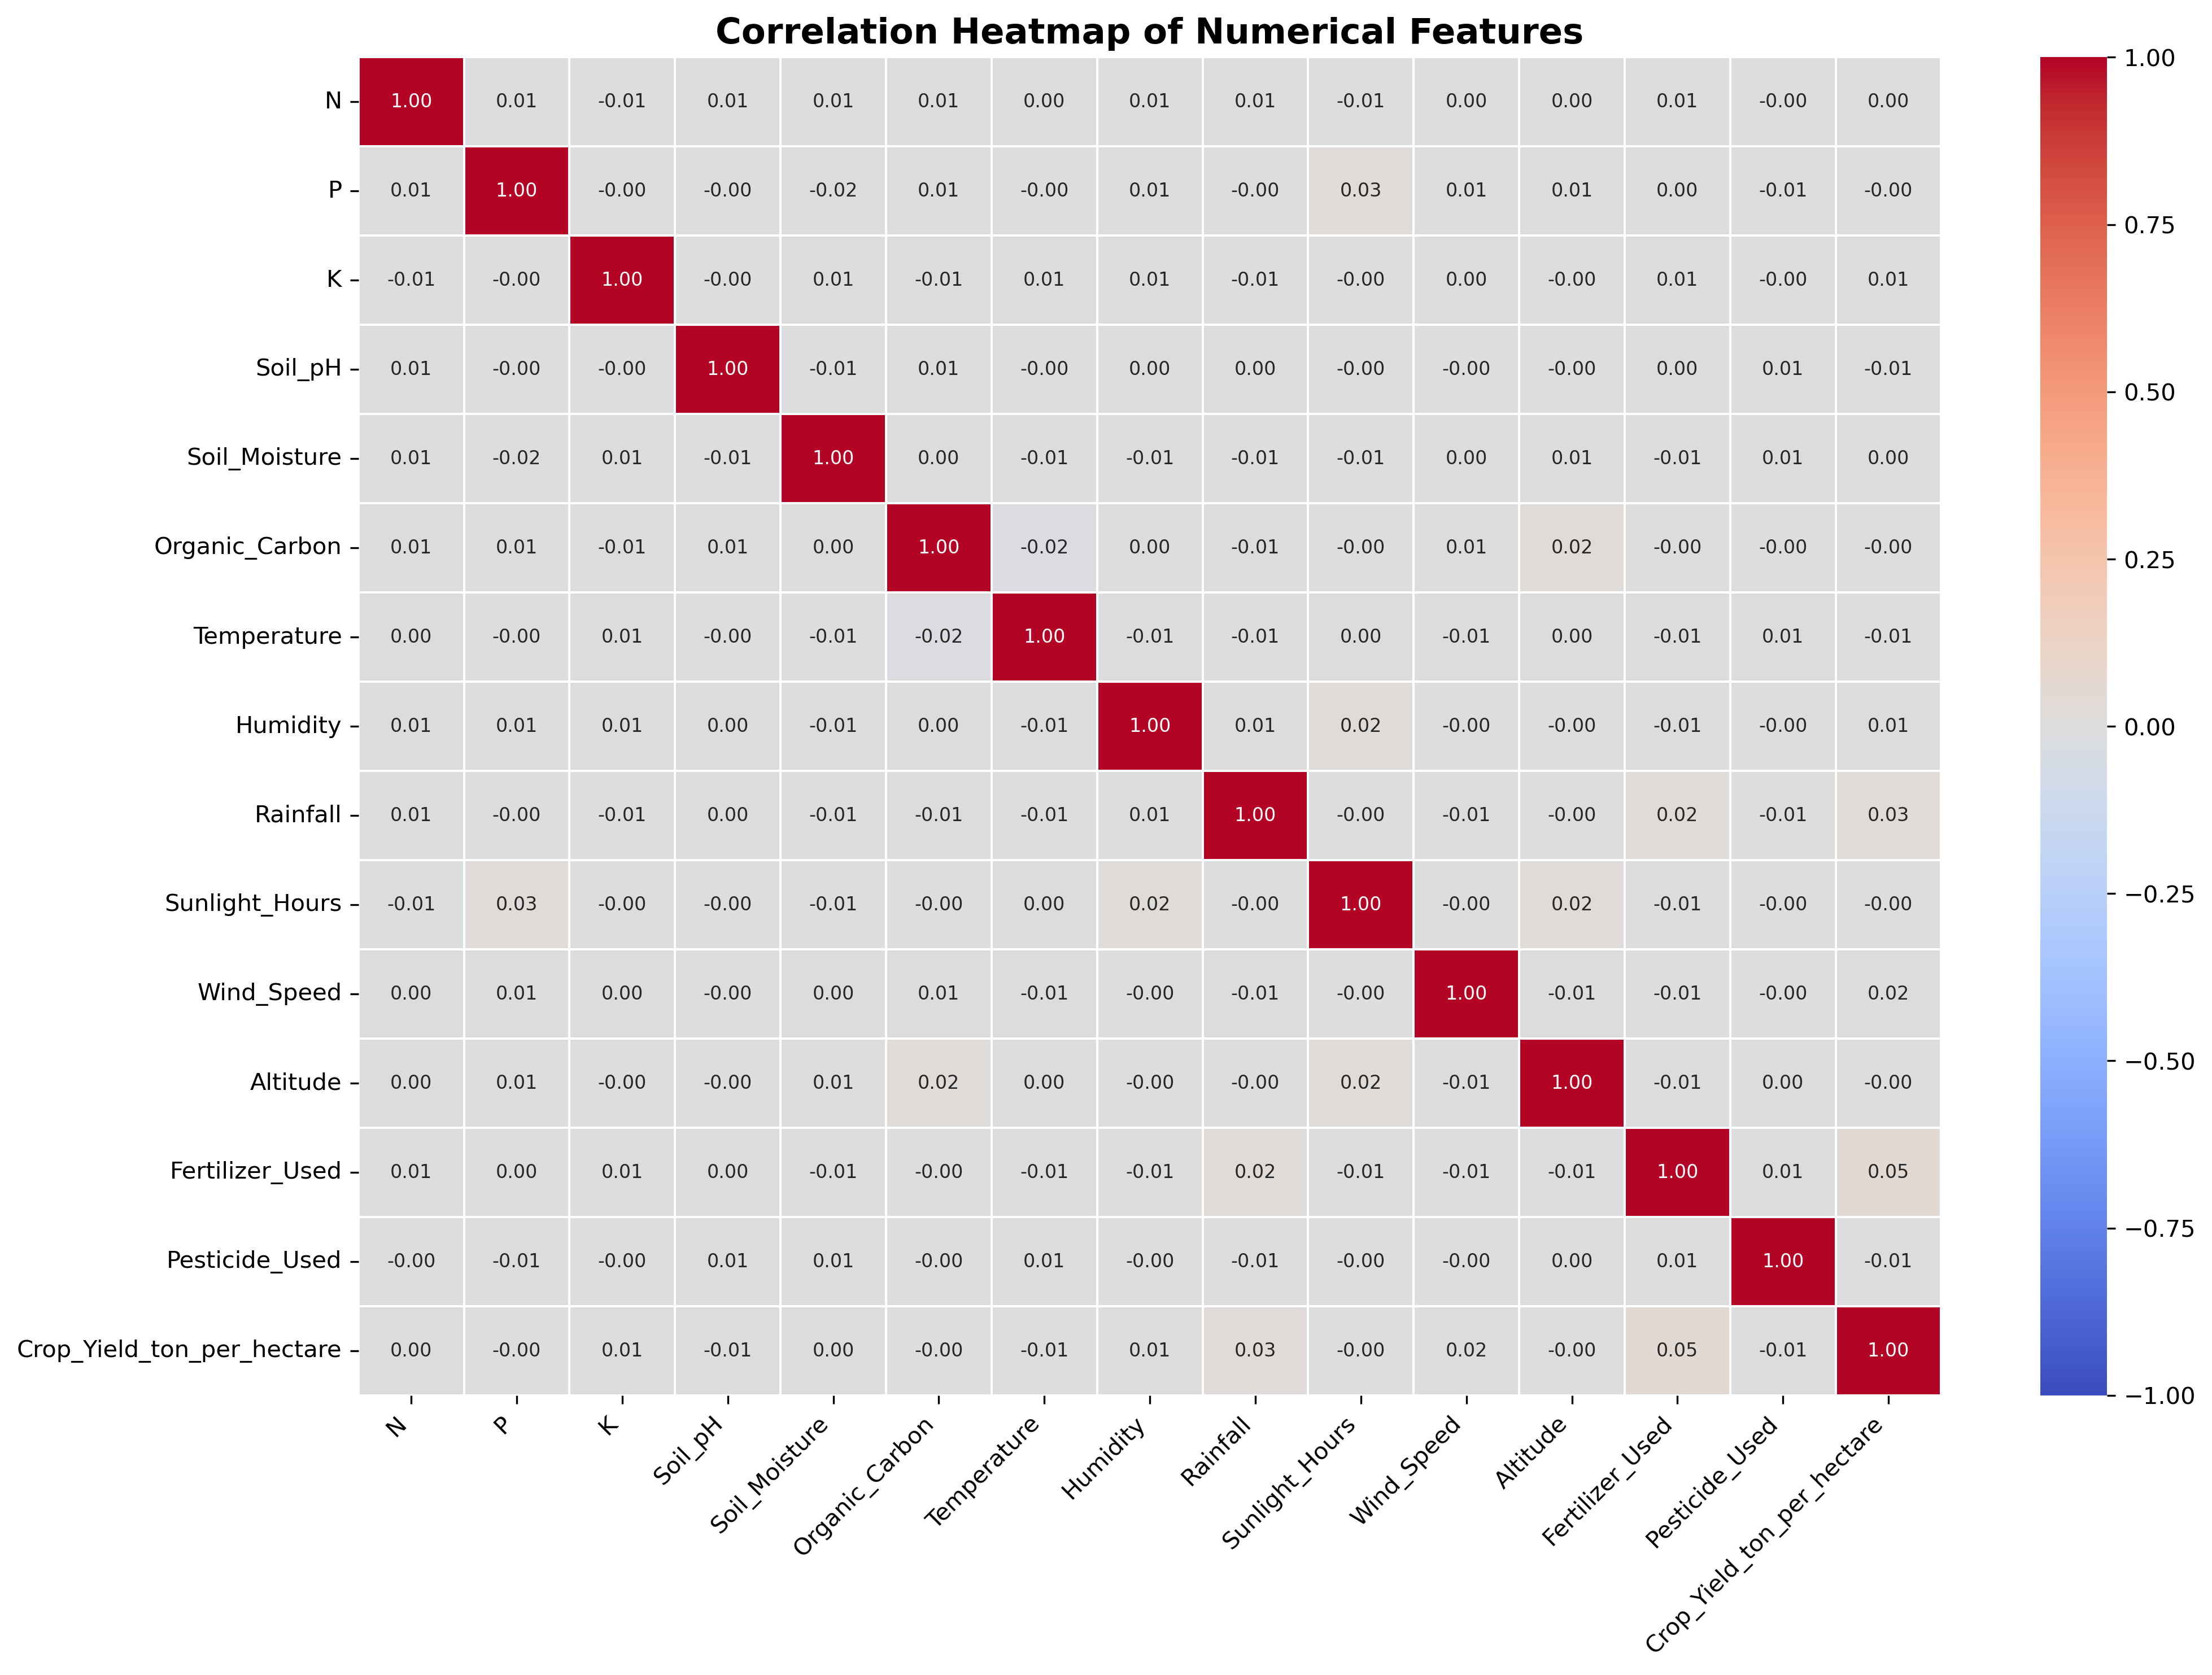



Data Preprocessing & Exploratory Analysis
Cleaning
Transformation
Feature Selection
Inspected the dataset for missing values and data-quality issues.
Applied median imputation to numerical features.
Applied StandardScaler to numerical features.
Applied OneHotEncoder to categorical features.
SelectKBest
Recursive Feature Elimination (RFE)
Final transformed feature matrix: 42 features.
Notes:
Show two or three plots that tell a story: distributions, correlations, outliers. Explain what each plot told you and what you did about it.

Slide 10
Module-wise Description
1
Dataset Collection & EDA
2
Data Preprocessing & Feature Engineering
Purpose: Understand the dataset and identify patterns in agricultural and environmental variables.
Input → Output: CSV dataset → EDA graphs and data insights.
Developed by: P. Sharmila
Purpose: Prepare data for model development and generate meaningful features.
Input → Output: Original features → cleaned and transformed 42-feature matrix.
Developed by: M.Pavani
3
Model Development & Evaluation
4
Prediction Dashboard & Reporting
Purpose: Train and compare different regression models and develop the stacking ensemble.
Input → Output: Processed dataset → trained models and performance metrics.
Developed by: P. Sharmila
Purpose: Provide an interactive prediction interface and analytical results.
Input → Output: 19 user inputs → predicted crop yield and downloadable CSV report.
Developed by: S.Sadhana
Notes:
Divide the project into three to five modules. For each, state its purpose, inputs, outputs and who built it. Duplicate a card if you have more modules.

Slide 11

Algorithms & Technologies Used
Data Preprocessing & Feature Engineering
Regression Algorithms
Stacking Ensemble
Why chosen:Handles numerical and categorical agricultural data.
Improves consistency of input data.
Creates additional relationships between agricultural variables.
Key settings:
Median imputation.
Most-frequent imputation.
StandardScaler.
OneHotEncoder.
Six engineered features.
Why chosen:To compare different approaches for predicting a continuous crop-yield value.
Models implemented:
Linear Regression
Decision Tree
Random Forest
Support Vector Regression (SVR)
K-Nearest Neighbors (KNN)
Gradient Boosting
HistGradient Boosting
Why chosen:Combines predictions from multiple base models.Uses a meta-learner to generate the final prediction.Allows different regression approaches to contribute to the final estimate.
Configuration:
Base models: Linear Regression, Random Forest, Gradient Boosting.
Random Forest: 200 estimators.
Selection criteria: Models were compared using MAE, MSE, RMSE and R² on the same held-out test set. The model with the best observed overall test performance was selected.
Notes:
Name each model, algorithm or technology, say why you chose it, and list the key settings. Then explain how you picked the final one.

Slide 12
Implementation / Model Building
Feature Selection
Code snippet / pseudocode
Started with 19 original input features.Created six engineered features.Evaluated feature subsets using SelectKBest and RFE.
X_train, X_test, y_train, y_test = train_test_split(
X, y,
test_size=0.20,
random_state=42
)
preprocessor.fit(X_train)
X_train_t = preprocessor.transform(X_train)
X_test_t = preprocessor.transform(X_test)
model.fit(X_train_t, y_train)
y_pred = model.predict(X_test_t)
Preprocessing Pipeline
Numerical features:Median Imputation,Standard Scaling.
Categorical features:Most Frequent Imputation,One-Hot Encoding.
Data Splitting
Training data: 80% – 8,000 records.
Testing data: 20% – 2,000 records.
Random state: 42.
Configuration
Stacking Regressor.Linear Regression, Random Forest and Gradient Boosting as base estimators.Ridge Regression as meta-learner.Five-fold KFold cross-validation.
Notes:
Describe the build in the order you did it. Paste only the most important code or pseudocode, not entire files. For hardware projects, show the circuit or wiring summary instead.

Slide 13
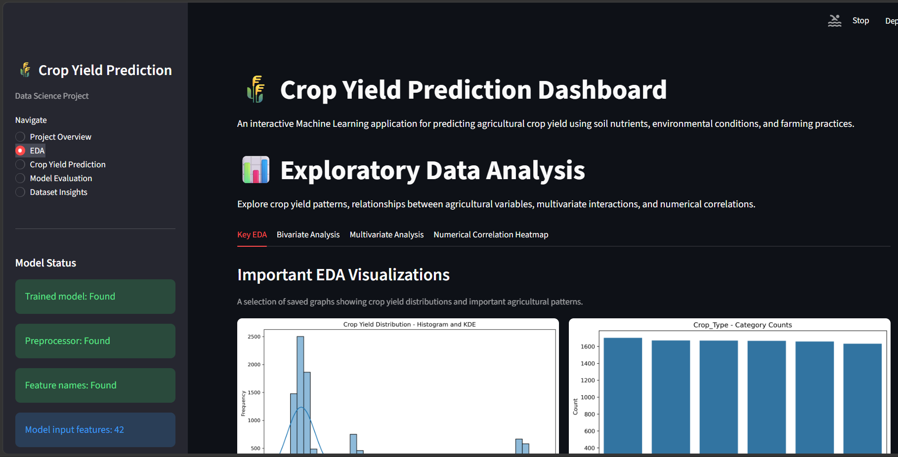
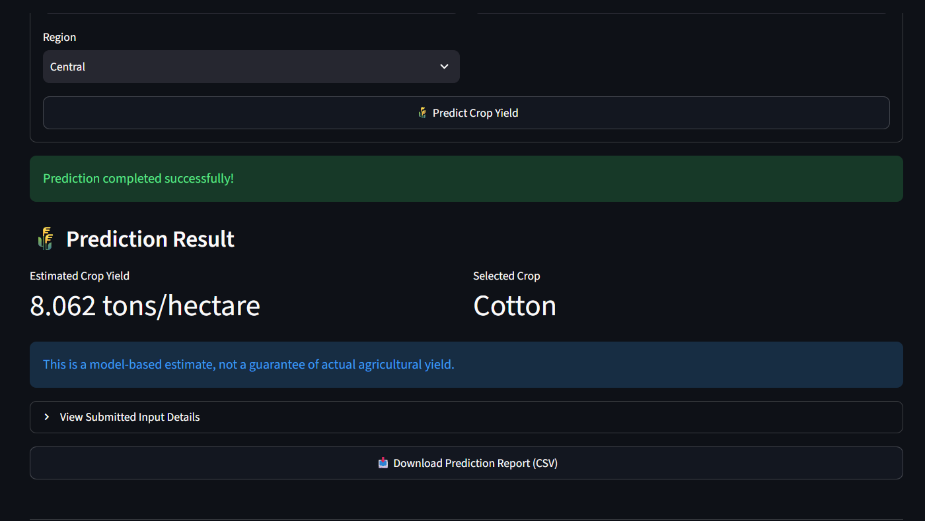
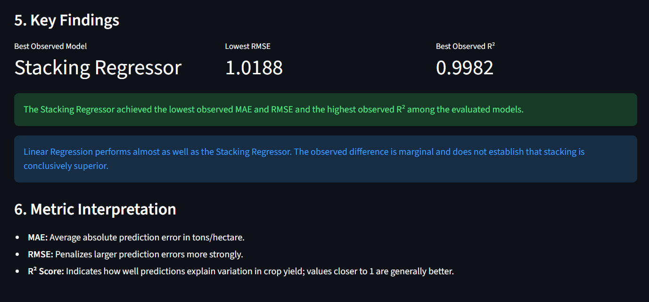
Working Prototype / Output Screens
Project Overview & EDA
The dashboard provides an overview of the crop-yield prediction project and interactive exploratory data analysis, including key distributions, bivariate analysis, multivariate analysis and numerical correlation.
Crop Yield Prediction
The prediction module accepts 19 agricultural and environmental inputs, validates the values and generates an estimated crop yield using the saved stacking model.
Model Evaluation & Dataset Insights
The dashboard displays model performance comparisons and dataset insights, helping users understand the predictive performance and characteristics of the dataset.
Notes:
Show real screenshots, photos of the hardware or a short demo video link. Caption each one with what the viewer should notice.

Slide 14
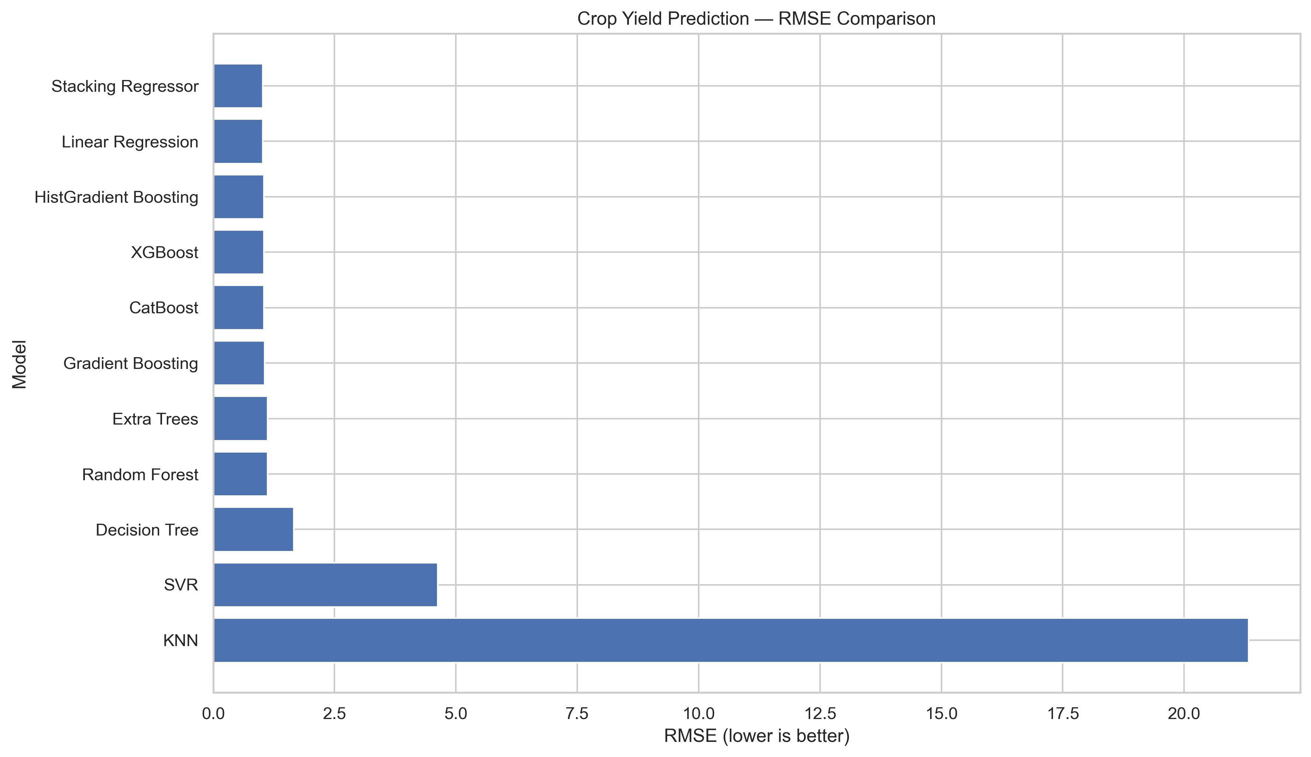
Results & Performance Comparison
Metric | Stacking | Linear Regression | HistGradient Boosting
MAE | 0.814537 | 0.816061 | 0.830327
MSE | 1.038037 | 1.041491 | 1.090591
RMSE | 1.018841 | 1.020534 | 1.044314
R² | 0.998219 | 0.998213 | 0.998129
Best Observed Model
Stacking Regressor
MAE: 0.814537
MSE: 1.038037
RMSE: 1.018841
R²: 0.998219
Notes:
Right-click the chart and choose Edit Data to enter your real numbers. Replace the metrics with the ones that fit your project (accuracy, latency, power, throughput, user rating). State clearly which option performed best.

Slide 15
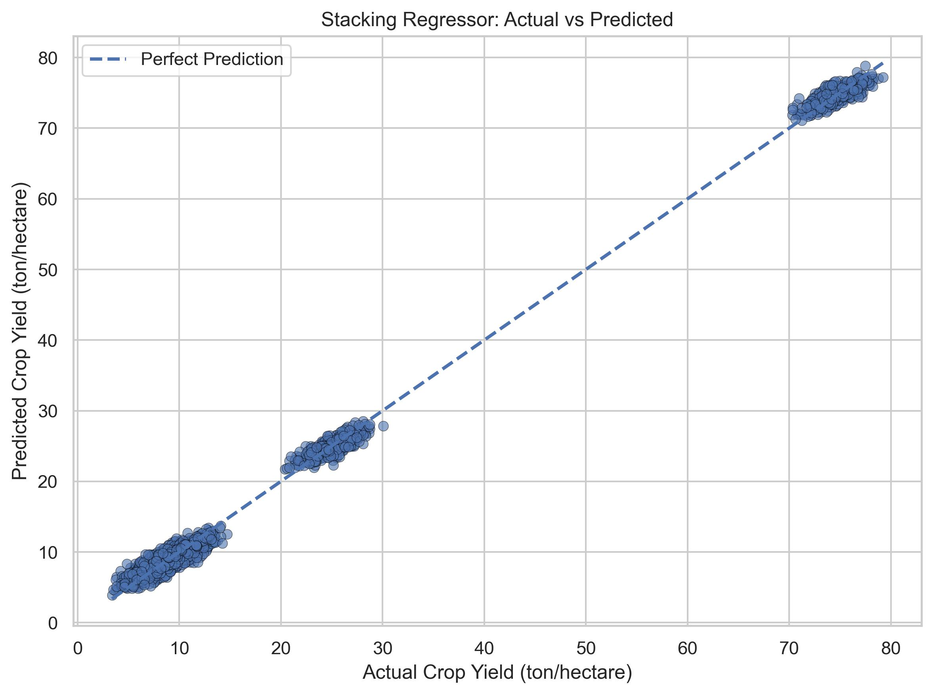
Analysis & Key Findings
99.82%
R² achieved by Stacking Regressor
R² achieved by Stacking Regressor
Interpretation: The stacking model achieved an R² of 0.998219 on the test dataset.
It produced an RMSE of 1.018841 and MAE of 0.814537.The results indicate strong predictive performance on the held-out dataset.
Error analysis:Maximum absolute error for the stacking model: 3.472214.
Model performance should be independently validated using additional datasets before real-world agricultural deployment.
Key drivers: Soil nutrients: Nitrogen, Phosphorus and Potassium.
Soil properties: pH, moisture and organic carbon.
Environmental factors: Rainfall, temperature, humidity and sunlight.
Agricultural factors: Crop type, irrigation and fertilizer usage.
Notes:
Explain what the numbers mean. Use a confusion matrix, ROC curve, feature-importance chart or output comparison. Be honest about weak results; panels value that.

Slide 16

Testing & Validation
Test ID | Test Description | Expected Result | Actual Result | Status
TC-01 | Dataset loading | Dataset should load successfully | 10,000 records loaded | Pass
TC-02 | Data preprocessing | Numerical and categorical features should be transformed | Preprocessing pipeline implemented | Pass
TC-03 | Model prediction | Model should generate a yield estimate | Prediction function validated | Pass
TC-04 | CSV report download | Prediction details should be downloadable | CSV report functionality implemented | Pass
Functional Testing
Validation Method
Performance Testing
Dataset loading and preprocessing.
Feature engineering and transformation
Model training and prediction.
Dashboard navigation and functionality.
Prediction validation and CSV report generation.
80:20 train-test split.
Five-fold KFold cross-validation within the stacking estimator.
Compared 11 regression models.
Evaluated MAE, MSE, RMSE and R²
Checked the prediction workflow and dashboard outputs.
Notes:
List representative test cases with expected and actual outcomes. Name the validation methods you used. Delete rows you do not need.

Slide 17


Challenges & Limitations
Challenges Faced
Limitations
1. Mixed Data Types
Challenge: Dataset contains both numerical and categorical variables.
Solution: Used ColumnTransformer with separate numerical and categorical preprocessing pipelines.
2. Feature Relationships
Challenge: Agricultural and environmental factors have different relationships with crop yield.
Solution: Created six engineered features representing nutrient combinations, ratios and environmental interactions.
3. Model Comparison
Challenge: Different algorithms produced different prediction results.
Solution: Compared 11 regression models using a common train-test split and evaluation metrics.
The project uses one structured Kaggle dataset.
External geographic and seasonal generalisation has not been independently established.
No real-time sensor or live weather integration is implemented.
Independent agricultural field validation is required before practical deployment.
Notes:
Be candid. Pair every challenge with how you solved it, and list limitations that the panel would otherwise spot themselves.

Slide 18

Conclusion
Developed a complete machine-learning-based crop-yield prediction system using a dataset containing 10,000 records and 19 agricultural and environmental input features.
1
Outcome
Implemented and compared 11 regression models. The Stacking Regressor achieved the best observed test performance:
- MAE: 0.814537
- RMSE: 1.018841
- R²: 0.998219
0.998219
Best Observed Test R²
Objectives Achieved: 4 out of 4
2
Data preprocessing and exploratory analysis.
Feature engineering and feature selection.
Regression model development and comparison.
Stacking ensemble implementation.
Interactive Streamlit dashboard.
Crop yield prediction and CSV report generation.
3
Notes:
Revisit each objective and say whether you met it. Quote your headline result with numbers. Do not introduce new material here.

Slide 19



Future Scope & Applications
Improve Performance
Explore additional ensemble techniques.
Perform broader hyperparameter tuning.
Evaluate prediction uncertainty.
Test models using independent datasets.
Applications
Farm-level seasonal crop-yield planning.
Agricultural advisory and resource allocation.
Regional crop production analysis.
Potential Users:
Farmers, agricultural analysts, researchers and agricultural service organisations.
Expand Data / Features
Integrate multi-year agricultural datasets.
Include additional soil and climatic measurements.
Expand to more crops and geographical regions.
Deploy & Build an Interface
Deploy the existing Streamlit dashboard online.
Develop an API for external applications
Add prediction history and user-specific reports.
Scale & Secure
Use cloud infrastructure for deployment.
Implement secure user access.
Monitor model performance and data drift.
Notes:
Give concrete next steps, ideally tied to the limitations. Then name two or three real-world uses.

Slide 20
Team Contribution
Reg. No. | Name | Contribution / Modules Handled
2420030042 | Pathi Sharmila | Data collection, preprocessing, Customer Segmentation
2420030225 | Sanivarapu Sadhana | RFM Analysis, Exploratory Data Analysis
2420030336 | Maddipatla Pavani Sree | Model Evaluation, Comparative Analysis ,Interactive Dashboard and Business Recommendations
Notes:
Show that work was planned and shared. Every member should be able to explain their own module.

Slide 21

References
[1] M. Abdel-Salam, N. Kumar, and S. Mahajan, “A proposed framework for crop yield prediction using hybrid feature selection approach and optimized machine learning,” Neural Computing and Applications, vol. 36, pp. 20723–20750, 2024.
[2] O. S. Nagesh et al., “Boosting enabled efficient machine learning technique for accurate prediction of crop yield towards precision agriculture,” Discover Sustainability, vol. 5, Art. no. 101, 2024.
[3] M. Ashfaq et al., “Accurate wheat yield prediction using machine learning and climate-NDVI data fusion,” IEEE Access, vol. 12, pp. 40947–40961, 2024.
[4] T. van Klompenburg, A. Kassahun, and C. Catal, “Crop yield prediction using machine learning: A systematic literature review,” Computers and Electronics in Agriculture, vol. 177, Art. no. 105709, 2020.
[5] P. S. Maya Gopal and R. Bhargavi, “A novel approach for efficient crop yield prediction,” Computers and Electronics in Agriculture, vol. 165, Art. no. 104968, 2019.
[6] L. Breiman, “Random forests,” Machine Learning, vol. 45, pp. 5–32, 2001.
[7] D. H. Wolpert, “Stacked generalization,” Neural Networks, vol. 5, no. 2, pp. 241–259, 1992.
Project Links
GitHub:
https://github.com/sharmi-pathi/KLH-CSE-2026-27-Team-3-Crop-Yield-Prediction
https://github.com/Sadhana1304/KLH-CSE-2026-27-Team-3-Crop-Yield-Prediction
https://github.com/PavaniSreeMaddipatla/KLH-CSE-2026-27-Team-3-Crop-Yield-Prediction
Notes:
Use IEEE style, numbered in order of first citation in the deck. Include datasets, documentation and code repositories.

Slide 22
THANK YOU
Questions & Discussion
[2420030042@klh.edu.in, 24200030225@klh.edu.in,2420030336klh.edu.in]
[Dr. N. Sunanda, Department Of CSE]
Notes:
Leave this slide up during questions. Make sure every team member can answer questions about their own module.

